Slide 1
BT 205: Cell & Molecular Biology
-Prof. Siddhartha Sankar Ghosh

Slide 2

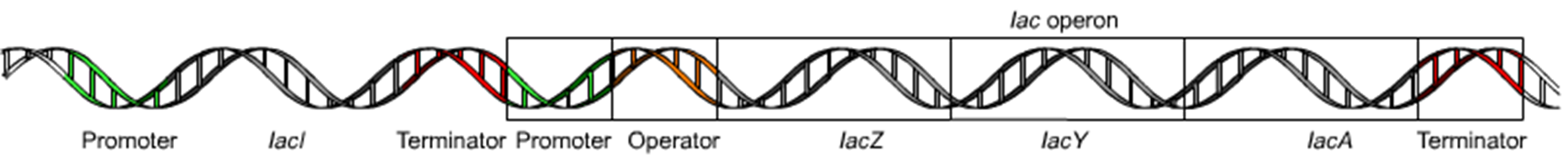

Slide 3
Regulation of β-galactosidase in diploid E. coli

Slide 4

The mating of two bacterial strains results in diploid cells that contain genes from both parents.
In these examples, it is assumed that the genes encoding β -galactosidase (the z genes) can be distinguished on the basis of structural gene mutations, designated
z¹ and z².
In an ;+/;- diploid, both structural genes are inducible; therefore ;+ is dominant over ;- and affects expression of z genes on both chromosomes.
In contrast, in an o^{c} I o⁺ diploid, the z gene linked to o^{c} is constitutively expressed, whereas that linked to o⁺ is inducible. Therefore o affects expression of only the adjacent z gene on the same chromosome.

Slide 5
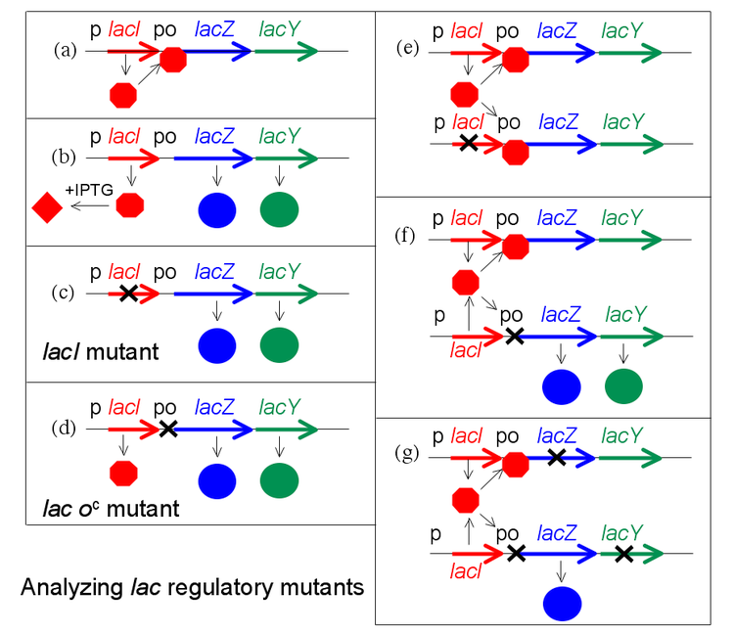

Slide 6
Q. Show synthesis of beta galactosidase, permease for the followings in presence and absence of IPTG and give brief reasons:
I⁺Z⁻Y⁺//I⁻Z⁺ Y⁺
O⁺Z⁻Y⁺//O^{c}Z⁺Y⁻

Slide 7
Answer:
a) Z +, + and Y +, +
b) Z+,+ and Y -, +

Slide 8
Q. A DNA element is consisting of four different DNA sequences A, B, C and D, where two sequences encode two genes 1 and 2, separately. Mutations in sequences A, B, C and D have the following effects as shown below in the table, where a plus sign (+) means enzyme is synthesized and a minus sign (-) means enzyme is not synthesized.
 | Potential inducer or repressor absent |  | Potential inducer or repressor present
 | Gene 1 | Gene 2 | Gene1 | Gene 2
No mutation | - | - | + | +
Mutation of A | - | - | - | +
Mutation of B | - | - | - | -
Mutation of C | - | - | + | -
Mutation of D | + | + | + | +
i. Indicate whether the DNA element is inducible or repressible?
ii. Mention which of the following sequences amongst A, B, C and D are part of: Promoter, Operator, gene 1 and gene 2?

Slide 9
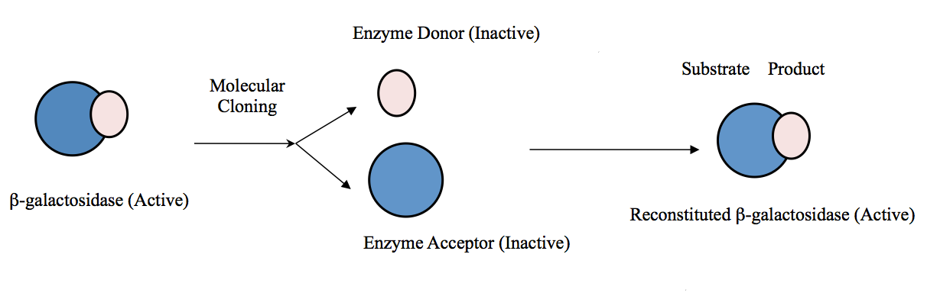
β-galactosidase α-Complementation

Slide 10
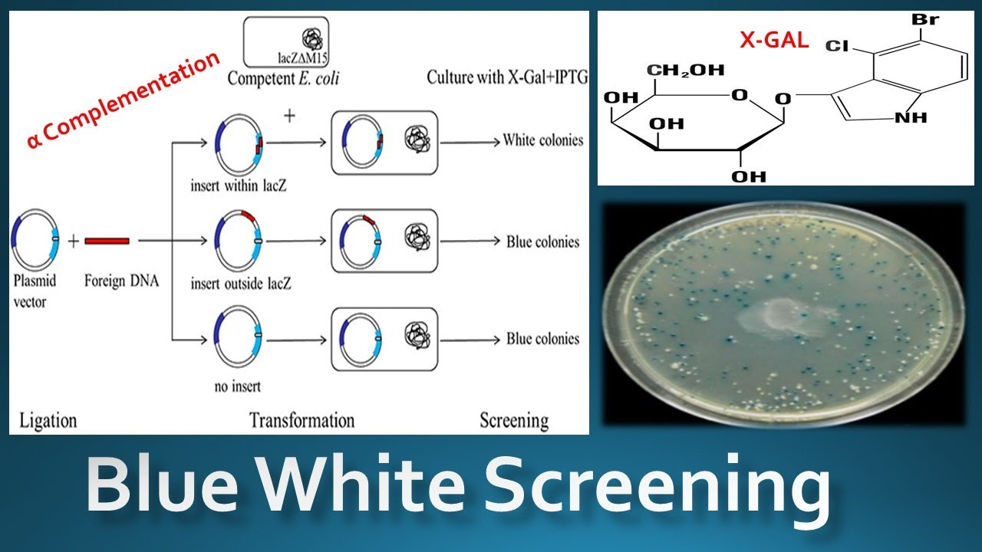

Slide 11
Formation of the primary transcript and its processing during maturation of mRNA in a eukaryotic cell

Slide 12
The 5′ cap has four main functions:
Regulation of nuclear export
Prevention of degradation by exonucleases
Promotion of translation
Promotion of 5′ proximal intron excision

Slide 13
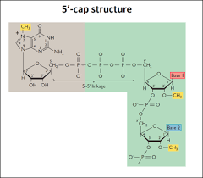
In eukaryotes, the 5′ cap (cap-0), found on the 5′ end of an mRNA molecule, consists of a guanine nucleotide connected to mRNA via an unusual 5′ to 5′ triphosphate linkage. This guanosine is methylated on the 7 position directly after capping in vivo by methyltransferase. It is referred to as a 7-methylguanylate cap, abbreviated m⁷G.

Slide 14
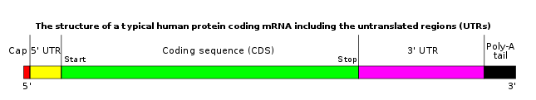
Polyadenylation:
It is the addition of a poly(A) tail to an RNA transcript, typically a messenger RNA (mRNA). The poly(A) tail consists of multiple adenosine monophosphates; in other words, it is a stretch of RNA that has only adenine bases. In eukaryotes, polyadenylation is part of the process that produces mature mRNA for translation.

Slide 15

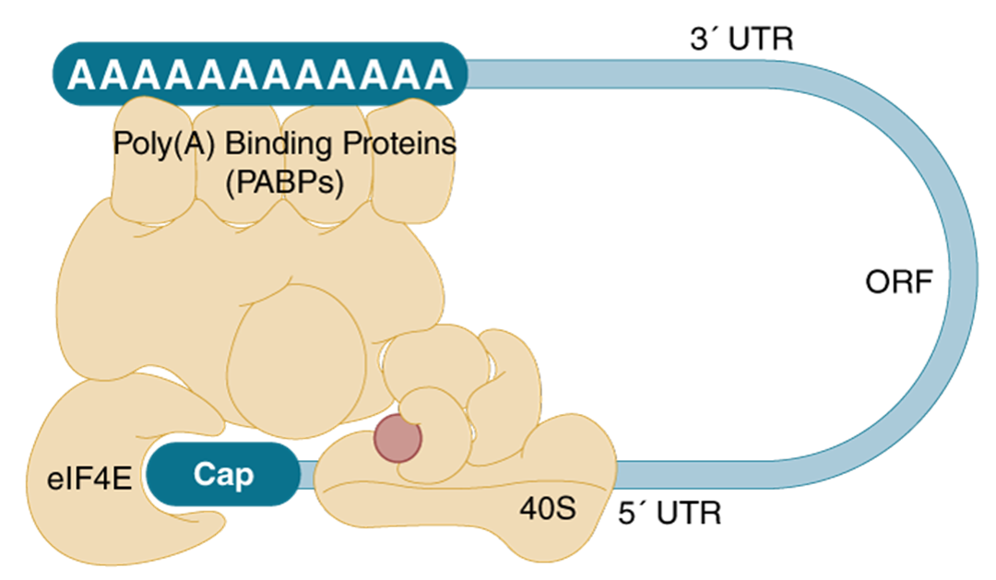

Slide 16
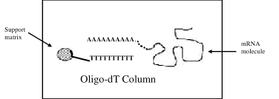
Oligo-dT Cellulose Columns. Oligo dT isolation is a very useful method for isolating sequences with a poly A tag.

Slide 17
Splicing mechanism of group I intron

Slide 18
Splicing mechanism of group II intron

Slide 19
THANK YOU

